Slide 1

Make uncertainty great again!
Notes:
I have wanted to give this presentation for quite some time, but due to other priorities I have not been able to do so! So I am sorry for being a bit rusty in some terminology, because I do not really work with this sort of problems on a day to day basis any more. This presentation was and is focused around my research for around 2.5 years ago, and a course I took in probabilistic machine learning, when I wanted to learn about uncertainties of our predictions made by our trained neural networks. I will not go into my research at that time, since I was focused on inverse problems in computational geophysics, which is not actually an intuitive domain to give these kinds of presentations. So the examples that I provide here are more toy examples from courses and learning material online. And of course, we can not jump over some of the fundamental understanding of probability theory and the mathematics behind it in order to pull you in to have sort of similar intuition of why/how/when we should/could integrate Bayesian learning into our problem space.
In these three figures you see here encapsulate some of the most important features of Baysian learning, where we want to estimate not only our best model fitted to the training data, but many different models, nest best, nest nest best and so on, which are sampled from the same model architecture. And for us to be able to do this, we need to estimate the probabilit distribution over our model parameters given the data that we observe!
Explain figures shortly.
So lets start diving into Bayesian thinking and the beautiful math that surrounds it!

Slide 2
Make uncertainty great again!
Why Bayesian learning (and thinking) is important
Uncertainty Quantification: In critical domains like healthcare or finance, uncertainty associated with predictions may be crucial for decision-making.
Robustness to Overfitting: Bayesian neural networks offer a natural regularization mechanism by placing priors over the network weights.
Handling Small Datasets: Bayesian neural networks can provide more robust predictions with limited data.
Model Flexibility: Uncertainty estimates provided by Bayesian methods can also help in model selection, allowing for more informed decisions about model architecture.
Notes:
Ok, so this is Bayes theorem, some of you may have seen it before, some have not, some of you understands it, and some of you do not.
So how should we read this probability?
Its then the probability of A given that B has happened is the probability of B given that A has happened times the probability of A happening, divided by the probability of B happening.

Slide 3
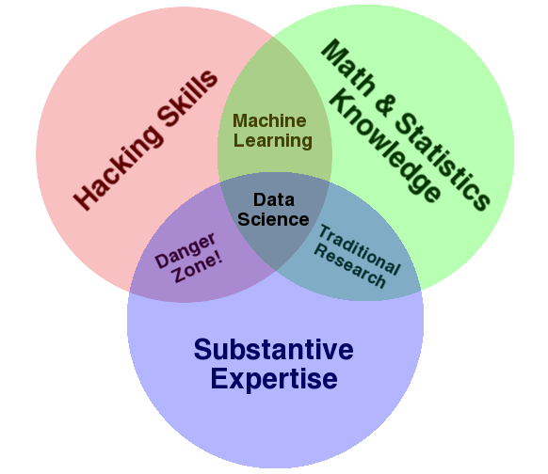

Make uncertainty great again!
Outline
- Fundamentals of Bayesian learning
- Motivating examples
- Do I have the disease?
- The deterministic doctor vs. the deterministic neural net?
- Cat vs. Dog?
- Notebook
- References and learning material
Data science
The data scientist
http://drewconway.com/zia/2013/3/26/the-data-science-venn-diagram
Notes:
Ok, so this is Bayes theorem, some of you may have seen it before, some have not, some of you understands it, and some of you do not.
So how should we read this probability?
Its then the probability of A given that B has happened is the probability of B given that A has happened times the probability of A happening, divided by the probability of B happening.

Slide 4

Make uncertainty great again!
Outline
- Fundamentals of Bayesian learning
- Motivating examples
- Do I have the disease?
- The deterministic doctor vs. the deterministic neural net?
- Cat vs. Dog?
- Notebook
- References and learning material
Data science
The data scientist
👎
http://drewconway.com/zia/2013/3/26/the-data-science-venn-diagram
Notes:
Ok, so this is Bayes theorem, some of you may have seen it before, some have not, some of you understands it, and some of you do not.
So how should we read this probability?
Its then the probability of A given that B has happened is the probability of B given that A has happened times the probability of A happening, divided by the probability of B happening.

Slide 5

Make uncertainty great again!
Outline
- Fundamentals of Bayesian learning
- Motivating examples
- Do I have the disease?
- The deterministic doctor vs. the deterministic neural net?
- Cat vs. Dog?
- Notebook
- References and learning material
Data science
The data scientist
👍
http://drewconway.com/zia/2013/3/26/the-data-science-venn-diagram
Notes:
Ok, so this is Bayes theorem, some of you may have seen it before, some have not, some of you understands it, and some of you do not.
So how should we read this probability?
Its then the probability of A given that B has happened is the probability of B given that A has happened times the probability of A happening, divided by the probability of B happening.

Slide 6
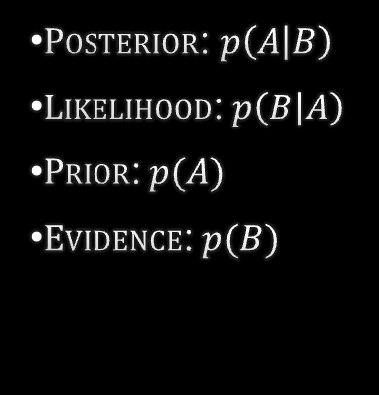

FUNDAMENTALs
Bayes theorem
$$p\left(A | B\right)=\frac{p\left(B | A\right)p(A)}{p(B)}$$
$Posterior$: $p\left(A | B\right)$
$Likelihood$:$p\left(B | A\right)$
$Prior$:$p(A)$
$Evidence$:$p(B)$
Notes:
Ok, so this is Bayes theorem, some of you may have seen it before, some have not, some of you understands it, and some of you do not.
So how should we read this probability?
Its then the probability of A given that B has happened is the probability of B given that A has happened times the probability of A happening, divided by the probability of B happening.

Slide 7

FUNDAMENTALs
Bayes theorem
$$p\left(A | B\right)=\frac{p\left(B | A\right)p(A)}{p(B)}$$
$$p\left(spam | word\right)=\frac{p\left(word | spam\right)p(spam)}{p(word)}$$
$Posterior$: $p\left(A | B\right)$
$Likelihood$:$p\left(B | A\right)$
$Prior$:$p(A)$
$Evidence$:$p(B)$

Slide 8

FUNDAMENTALs
Bayes theorem
$$p\left(A | B\right)=\frac{p\left(B | A\right)p(A)}{p(B)}$$
$$p\left(nerd | thomas\right)=\frac{p\left(thomas | nerd\right)p(nerd)}{p(thomas)}$$
$Posterior$: $p\left(A | B\right)$
$Likelihood$:$p\left(B | A\right)$
$Prior$:$p(A)$
$Evidence$:$p(B)$

Slide 9
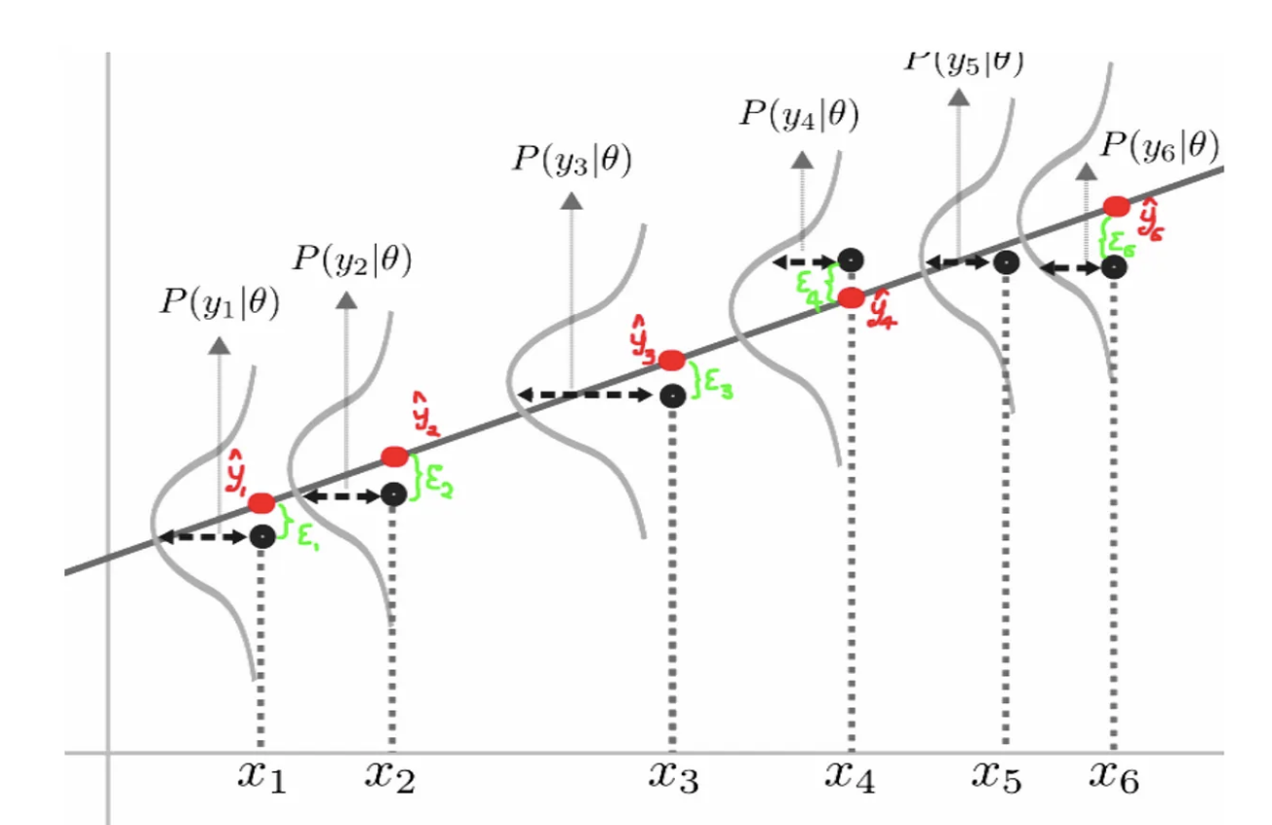

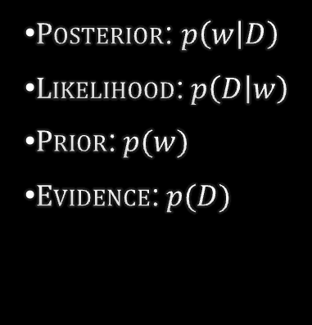
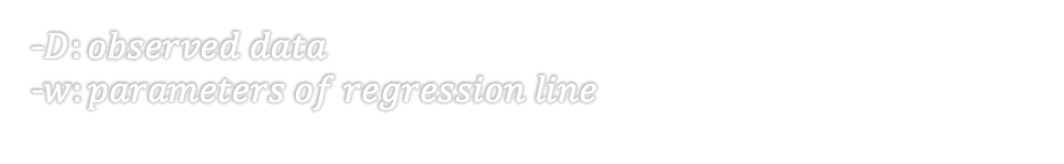

https://towardsdatascience.com/bayesian-thinking-estimating-posterior-distribution-for-linear-regression-data-ketchup-2f50a597eb06
FUNDAMENTALs
Bayes theorem
$$\hat{y}=f\left(x;w\right)$$
$$p\left(w | D\right)=\frac{p\left(D | w\right)p(w)}{p(D)}$$
-$D:observed data$
-$w:parameters of regression line$
$Posterior$: $p\left(w | D\right)$
$Likelihood$:$p\left(D | w\right)$
$Prior$:$p(w)$
$Evidence$:$p(D)$

Slide 10

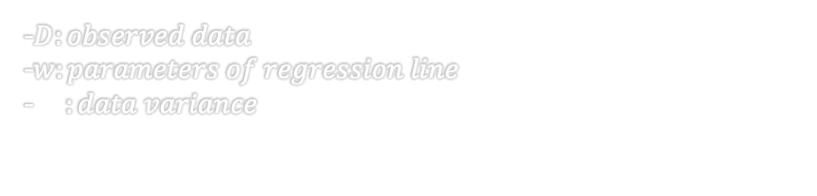

https://towardsdatascience.com/bayesian-thinking-estimating-posterior-distribution-for-linear-regression-data-ketchup-2f50a597eb06
FUNDAMENTALs
Bayes theorem
$$\hat{y}=f\left(x;w\right)$$
$$p\left(D | w\right)=\frac{1}{\sqrt{2πσ_{D}^{2} }}e^{−\frac{{\left(D−\hat{y}\right)}^{2}}{2σ_{D}^{2}}}$$
$$p\left(w | D\right)=\frac{p\left(D | w\right)p(w)}{p(D)}$$
-$D:observed data$
-$w:parameters of regression line$
-$σ_{D}^{2}:data variance$
$Posterior$: $p\left(w | D\right)$
$Likelihood$:$p\left(D | w\right)$
$Prior$:$p(w)$
$Evidence$:$p(D)$

Slide 11
https://towardsdatascience.com/bayesian-thinking-estimating-posterior-distribution-for-linear-regression-data-ketchup-2f50a597eb06
FUNDAMENTALs
Bayes theorem
$$\hat{y}=f\left(x;w\right)$$
$$p\left(D | w\right)=\frac{1}{\sqrt{2πσ_{D}^{2} }}e^{−\frac{{\left(D−\hat{y}\right)}^{2}}{2σ_{D}^{2}}}$$
$$p\left(w | D\right)=\frac{p\left(D | w\right)p(w)}{p(D)}$$
Maximize
-$D:observed data$
-$w:parameters of regression line$
-$σ_{D}^{2}:data variance$
$Posterior$: $p\left(w | D\right)$
$Likelihood$:$p\left(D | w\right)$
$Prior$:$p(w)$
$Evidence$:$p(D)$

Slide 12
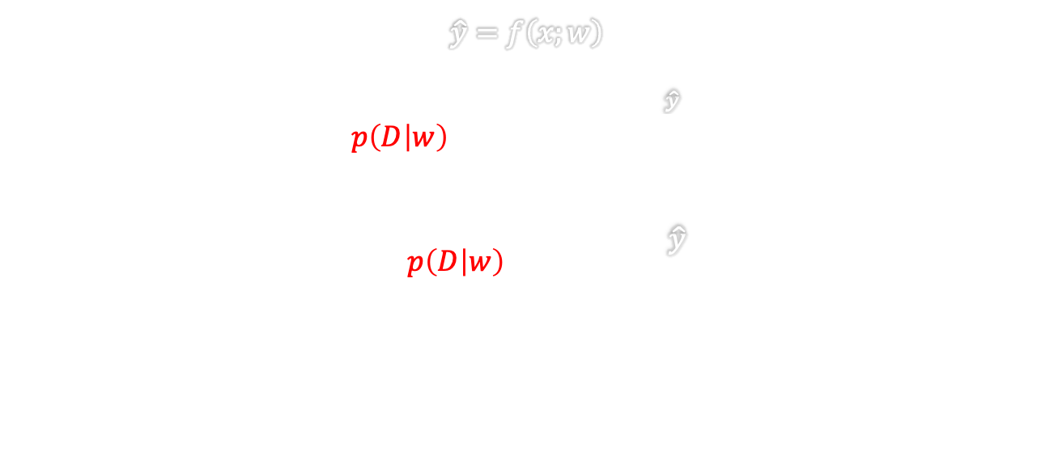
https://towardsdatascience.com/bayesian-thinking-estimating-posterior-distribution-for-linear-regression-data-ketchup-2f50a597eb06
FUNDAMENTALs
Bayes theorem
$$\hat{y}=f\left(x;w\right)$$
$$p\left(D | w\right)=\frac{1}{\sqrt{2πσ_{D}^{2} }}e^{−\frac{{\left(D−\hat{y}\right)}^{2}}{2σ_{D}^{2}}}$$
$$−log{p\left(D | w\right)}=k+\frac{{\left(D−\hat{y}\right)}^{2}}{2σ_{D}^{2}}$$
$$p\left(w | D\right)=\frac{p\left(D | w\right)p(w)}{p(D)}$$
Maximize
-$D:observed data$
-$w:parameters of regression line$
-$σ_{D}^{2}:data variance$
Minimize
$Posterior$: $p\left(w | D\right)$
$Likelihood$:$p\left(D | w\right)$
$Prior$:$p(w)$
$Evidence$:$p(D)$

Slide 13
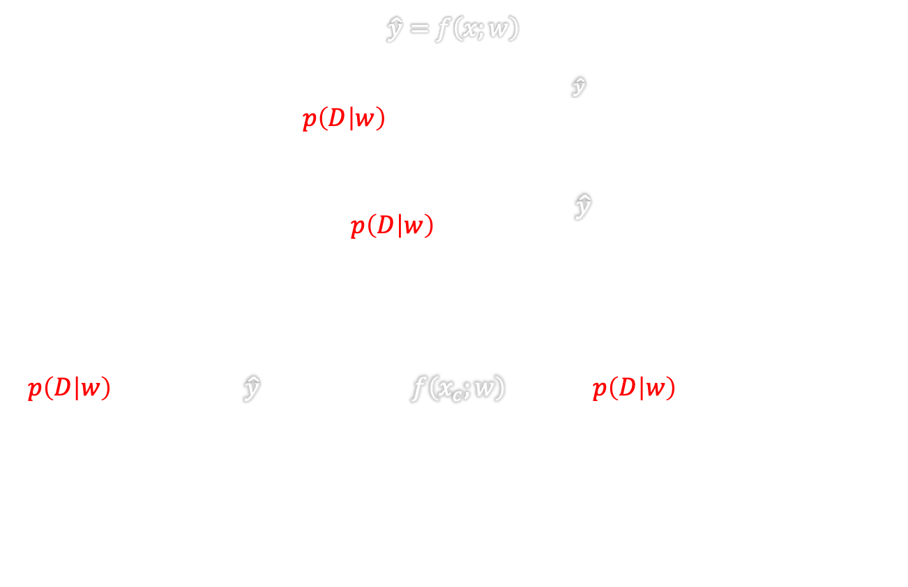
https://towardsdatascience.com/bayesian-thinking-estimating-posterior-distribution-for-linear-regression-data-ketchup-2f50a597eb06
FUNDAMENTALs
Bayes theorem
$$\hat{y}=f\left(x;w\right)$$
$$p\left(D | w\right)=\frac{1}{\sqrt{2πσ_{D}^{2} }}e^{−\frac{{\left(D−\hat{y}\right)}^{2}}{2σ_{D}^{2}}}$$
$$−log{p\left(D | w\right)}=k+\frac{{\left(D−\hat{y}\right)}^{2}}{2σ_{D}^{2}}$$
$$p\left(D | w\right)=\prod_{c}{p\left(t_{c} | {\hat{y}}_{c}\right)}=\prod_{c}{p\left(t_{c} | f\left(x_{c};w\right)\right)→log p\left(D | w\right)=\sum_{c}{log p\left(t_{c} | w\right)}⁡}$$
$$p\left(w | D\right)=\frac{p\left(D | w\right)p(w)}{p(D)}$$
-$D:observed data$
-$w:parameters of regression line$
-$σ_{D}^{2}:data variance$
$Posterior$: $p\left(w | D\right)$
$Likelihood$:$p\left(D | w\right)$
$Prior$:$p(w)$
$Evidence$:$p(D)$
Maximum likelihood
Notes:
So if you only rely on the likelihood term in the Bayes formula, you are performing maximum likelihood estimation, i.e., you are in a sense believing that all the information that I need in order to get a correct model are given by the data.
Or in other words, if I have small amount of data, I need a simple model, and in order to provide a more complex model I need more data.
In a sense this is true, since complex models, i.e., a lot of features would potentially or most likely overfit.
However, we may ask ourselves, do we only need or want the one model that fit the data that we have best? Or do we want a mixture of models that may provide different outcomes, i.e., possibly more vague predictions?
The maximum likelihood estimation given a Gaussion distributuion on the data error, we see that this may also be written as a sum over log probabilities, which is mathematically more conveniant.

Slide 14
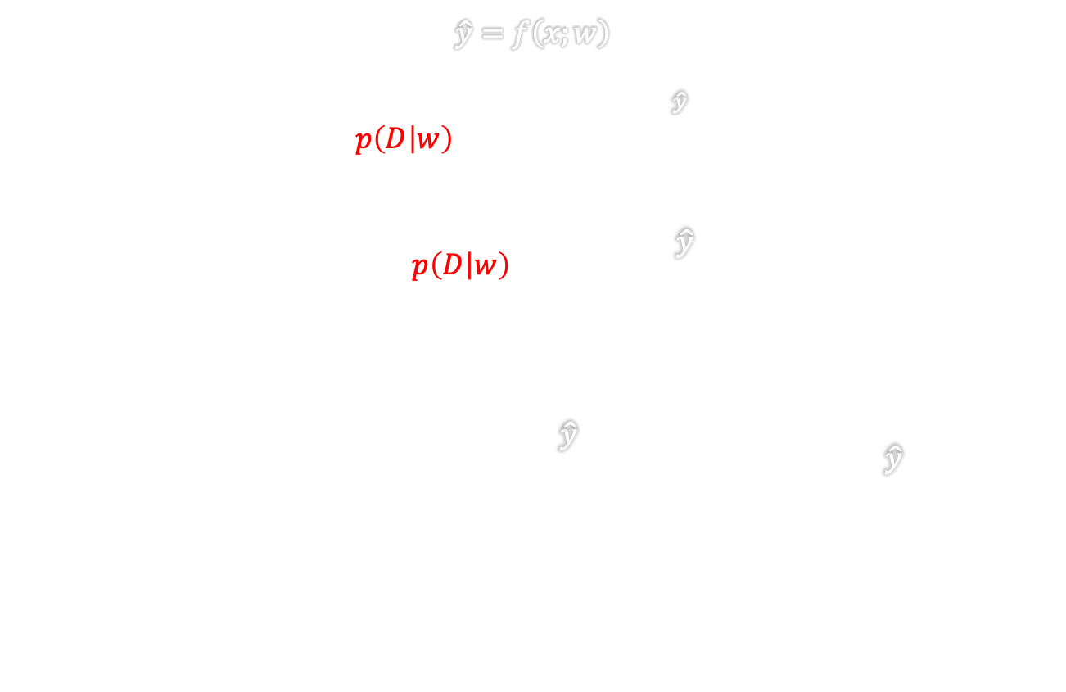
https://towardsdatascience.com/bayesian-thinking-estimating-posterior-distribution-for-linear-regression-data-ketchup-2f50a597eb06
FUNDAMENTALs
Bayes theorem
$$\hat{y}=f\left(x;w\right)$$
$$p\left(D | w\right)=\frac{1}{\sqrt{2πσ_{D}^{2} }}e^{−\frac{{\left(D−\hat{y}\right)}^{2}}{2σ_{D}^{2}}}$$
$$−log{p\left(D | w\right)}=k+\frac{{\left(D−\hat{y}\right)}^{2}}{2σ_{D}^{2}}$$
$$−\sum_{c}{\log{p\left(t_{c} | w\right)}}=\sum_{c}{k+\frac{{\left(t_{c}−{\hat{y}}_{c}\right)}^{2}}{2σ_{D}^{2}}}=K+\frac{1}{2σ_{D}^{2}}\sum_{c}{{\left(t_{c}−{\hat{y}}_{c}\right)}^{2}}$$
$$p\left(w | D\right)=\frac{p\left(D | w\right)p(w)}{p(D)}$$
-$D:observed data$
-$w:parameters of regression line$
-$σ_{D}^{2}:data variance$
$Posterior$: $p\left(w | D\right)$
$Likelihood$:$p\left(D | w\right)$
$Prior$:$p(w)$
$Evidence$:$p(D)$
Maximum likelihood
Notes:
And now if you take the negative of the log probs you get this term, which is just a ”large” constant K + a summation over the squared data errors scaled by the inverse of the variance of the data.
And some of you may have heard about mean squared error, which is one of the most used loss functions in deep learning, we can see here that

Slide 15
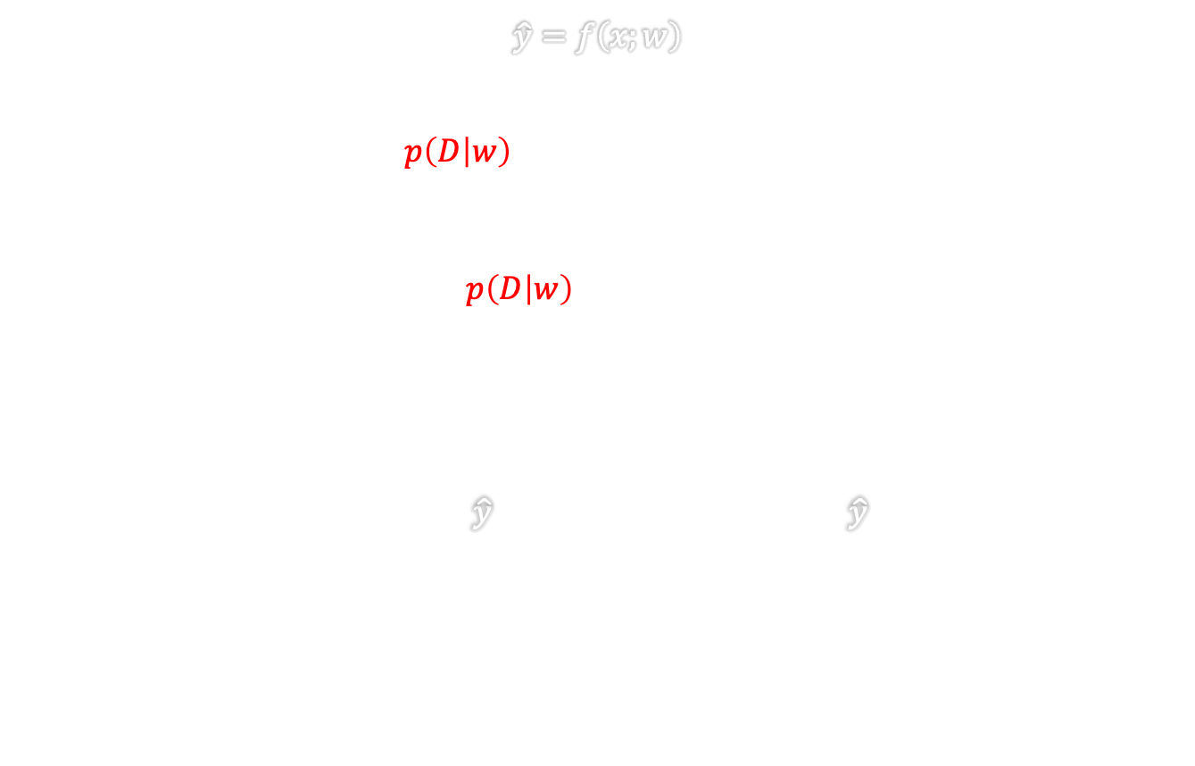
https://towardsdatascience.com/bayesian-thinking-estimating-posterior-distribution-for-linear-regression-data-ketchup-2f50a597eb06
FUNDAMENTALs
Bayes theorem
$$\hat{y}=f\left(x;w\right)$$
$$p\left(D | w\right)=\frac{1}{\sqrt{2πσ_{D}^{2} }}e^{−\frac{{\left(D−\hat{y}\right)}^{2}}{2σ_{D}^{2}}}$$
$$−log{p\left(D | w\right)}=k+\frac{{\left(D−\hat{y}\right)}^{2}}{2σ_{D}^{2}}$$
$$\frac{1}{2σ_{D}^{2}}\sum_{c}{{\left(t_{c}−{\hat{y}}_{c}\right)}^{2}}→MSE=\frac{1}{N}\sum_{c=1}^{N}{{\left(t_{c}−{\hat{y}}_{c}\right)}^{2}}$$
$$p\left(w | D\right)=\frac{p\left(D | w\right)p(w)}{p(D)}$$
-$D:observed data$
-$w:parameters of regression line$
-$σ_{D}^{2}:data variance$
$Posterior$: $p\left(w | D\right)$
$Likelihood$:$p\left(D | w\right)$
$Prior$:$p(w)$
$Evidence$:$p(D)$
Maximum likelihood
Notes:
Using the maximum likelihood estimation is more or less queal to the mean squared error, but derived from a probabilistic perspective.

Slide 16
https://towardsdatascience.com/bayesian-thinking-estimating-posterior-distribution-for-linear-regression-data-ketchup-2f50a597eb06
FUNDAMENTALs
Bayes theorem
$$\hat{y}=f\left(x;w\right)$$
$$p\left(D | w\right)=\frac{1}{\sqrt{2πσ_{D}^{2} }}e^{−\frac{{\left(D−\hat{y}\right)}^{2}}{2σ_{D}^{2}}}$$
$$−log{p\left(D | w\right)}=k+\frac{{\left(D−\hat{y}\right)}^{2}}{2σ_{D}^{2}}$$
$$\frac{1}{2σ_{D}^{2}}\sum_{c}{{\left(t_{c}−{\hat{y}}_{c}\right)}^{2}}→MSE=\frac{1}{N}\sum_{c=1}^{N}{{\left(t_{c}−{\hat{y}}_{c}\right)}^{2}}$$
$$p\left(w | D\right)=\frac{p\left(D | w\right)p(w)}{p(D)}$$
-$D:observed data$
-$w:parameters of regression line$
-$σ_{D}^{2}:data variance$
$Posterior$: $p\left(w | D\right)$
$Likelihood$:$p\left(D | w\right)$
$Prior$:$p(w)$
$Evidence$:$p(D)$
Maximum likelihood
When to use?
Notes:
No Prior Knowledge
Simplicity and Clarity
Large Sample Sizes

Slide 17
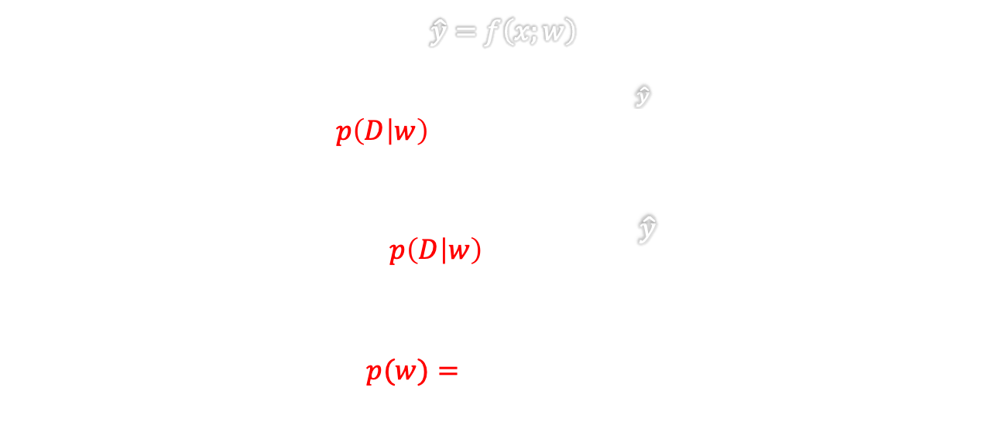
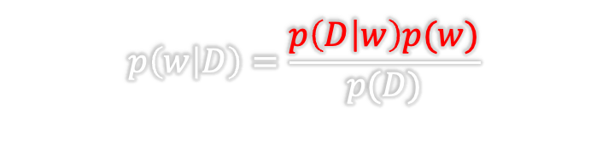
https://towardsdatascience.com/bayesian-thinking-estimating-posterior-distribution-for-linear-regression-data-ketchup-2f50a597eb06
FUNDAMENTALs
Bayes theorem
$$\hat{y}=f\left(x;w\right)$$
$$p\left(D | w\right)=\frac{1}{\sqrt{2πσ_{D}^{2} }}e^{−\frac{{\left(D−\hat{y}\right)}^{2}}{2σ_{D}^{2}}}$$
$$−log{p\left(D | w\right)}=k+\frac{{\left(D−\hat{y}\right)}^{2}}{2σ_{D}^{2}}$$
$$p(w)=\frac{1}{\sqrt{2πσ_{w}^{2}}}e^{−\frac{{\left(w\right)}^{2}}{2σ_{w}^{2}}}$$
$$p\left(w | D\right)=\frac{p\left(D | w\right)p(w)}{p(D)}$$
-$D:observed data$
-$w:parameters of regression line$
-$σ_{D}^{2}:data variance$
$Posterior$: $p\left(w | D\right)$
$Likelihood$:$p\left(D | w\right)$
$Prior$:$p(w)$
$Evidence$:$p(D)$
Notes:
Now lets look a bit deeper into the Baysian thinking where we now introduce the prior into our estimation problem. First, since we have established that working in the log probablility domain is more conveniant, lets start by taking the log of Bayes formula.
Then we get this term.

Slide 18
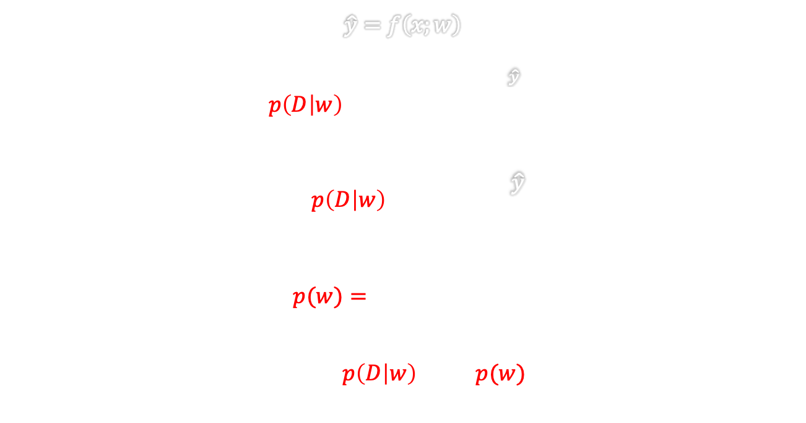
https://towardsdatascience.com/bayesian-thinking-estimating-posterior-distribution-for-linear-regression-data-ketchup-2f50a597eb06
FUNDAMENTALs
Bayes theorem
$$\hat{y}=f\left(x;w\right)$$
$$p\left(D | w\right)=\frac{1}{\sqrt{2πσ_{D}^{2} }}e^{−\frac{{\left(D−\hat{y}\right)}^{2}}{2σ_{D}^{2}}}$$
$$−log{p\left(D | w\right)}=k+\frac{{\left(D−\hat{y}\right)}^{2}}{2σ_{D}^{2}}$$
$$p(w)=\frac{1}{\sqrt{2πσ_{w}^{2}}}e^{−\frac{{\left(w\right)}^{2}}{2σ_{w}^{2}}}$$
$$log p\left(w | D\right)=\log{p\left(D | w\right){+}\log{p(w)}−\log{p(D)}}$$
$$p\left(w | D\right)=\frac{p\left(D | w\right)p(w)}{p(D)}$$
-$D:observed data$
-$w:parameters of regression line$
-$σ_{D}^{2}:data variance$
$Posterior$: $p\left(w | D\right)$
$Likelihood$:$p\left(D | w\right)$
$Prior$:$p(w)$
$Evidence$:$p(D)$
Notes:
And lets put a negative on this one also. Ok so now we have this equation aligned, but what about the probability term in the denominator?
We in this Baysian thinking we do not want the full posterior distributionm, i.e., the full Bayesian thinking, but instead believing that we have some sort of prior information about the distribution on the weights, but we still only want the most likeli ones, but as a tradeoff between the probabilities of the data term and the parameter term. So if we only want to maximize the probability of the posterior, we do not need the scale it such that it integrates to 1 and the thus the probability over the data distribution is ignored.

Slide 19
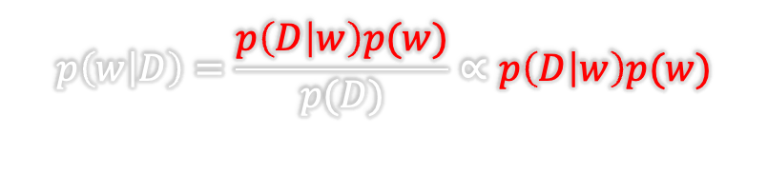
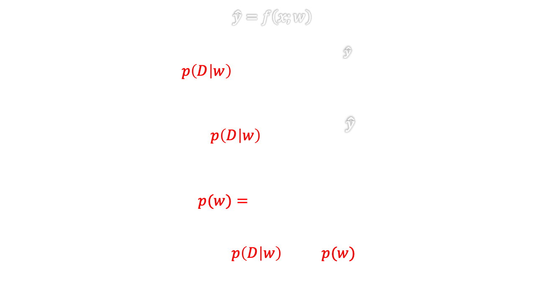
https://towardsdatascience.com/bayesian-thinking-estimating-posterior-distribution-for-linear-regression-data-ketchup-2f50a597eb06
FUNDAMENTALs
Bayes theorem
$$\hat{y}=f\left(x;w\right)$$
$$p\left(D | w\right)=\frac{1}{\sqrt{2πσ_{D}^{2} }}e^{−\frac{{\left(D−\hat{y}\right)}^{2}}{2σ_{D}^{2}}}$$
$$−log{p\left(D | w\right)}=k+\frac{{\left(D−\hat{y}\right)}^{2}}{2σ_{D}^{2}}$$
$$p(w)=\frac{1}{\sqrt{2πσ_{w}^{2}}}e^{−\frac{{\left(w\right)}^{2}}{2σ_{w}^{2}}}$$
$$log p\left(w | D\right)=\log{p\left(D | w\right){+}\log{p(w)}−\log{p(D)}}$$
$$p\left(w | D\right)=\frac{p\left(D | w\right)p(w)}{p(D)}∝p\left(D | w\right)p(w)$$
-$D:observed data$
-$w:parameters of regression line$
-$σ_{D}^{2}:data variance$
$$maximum is independent of normalization$$
$Posterior$: $p\left(w | D\right)$
$Likelihood$:$p\left(D | w\right)$
$Prior$:$p(w)$
$Evidence$:$p(D)$
Ignore this term
Notes:
Or in other words, the posterior distribution is proportional to the likelihood multiplied with the prior and does not depend on the normalizing constant. So we ignore the parameter independent term.

Slide 20
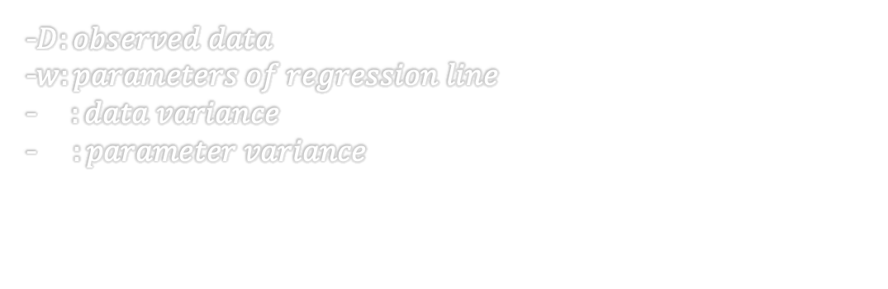
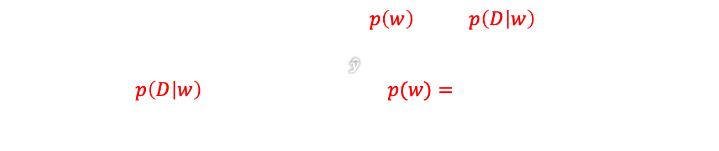
https://towardsdatascience.com/bayesian-thinking-estimating-posterior-distribution-for-linear-regression-data-ketchup-2f50a597eb06
FUNDAMENTALs
Bayes theorem
Maximum a posteriori
$$p\left(w | D\right)=\frac{p\left(D | w\right)p(w)}{p(D)}$$
$$−log p\left(w | D\right)=−log{p\left(w\right)−\log{p\left(D | w\right)}}$$
$$p\left(D | w\right)=\frac{1}{\sqrt{2πσ_{D}^{2} }}e^{−\frac{{\left(D−\hat{y}\right)}^{2}}{2σ_{D}^{2}}} , p(w)=\frac{1}{\sqrt{2πσ_{w}^{2}}}e^{−\frac{{\left(w\right)}^{2}}{2σ_{w}^{2}}}$$
-$D:observed data$
-$w:parameters of regression line$
-$σ_{D}^{2}:data variance$
-$σ_{w}^{2}:parameter variance$
$Posterior$: $p\left(w | D\right)$
$Likelihood$:$p\left(D | w\right)$
$Prior$:$p(w)$
$Evidence$:$p(D)$

Slide 21
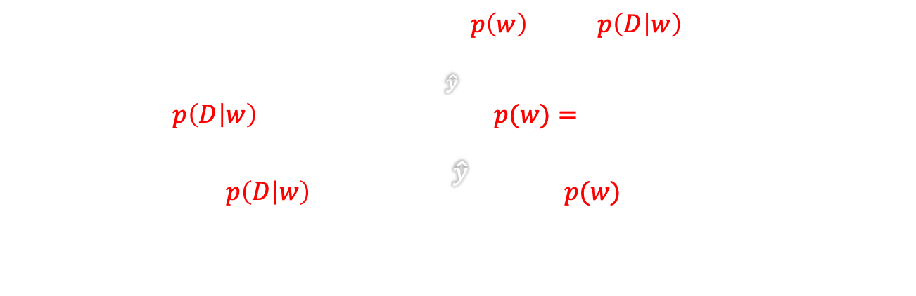
https://towardsdatascience.com/bayesian-thinking-estimating-posterior-distribution-for-linear-regression-data-ketchup-2f50a597eb06
FUNDAMENTALs
Bayes theorem
Maximum a posteriori
$$p\left(w | D\right)=\frac{p\left(D | w\right)p(w)}{p(D)}$$
$$−log p\left(w | D\right)=−log{p\left(w\right)−\log{p\left(D | w\right)}}$$
$$p\left(D | w\right)=\frac{1}{\sqrt{2πσ_{D}^{2} }}e^{−\frac{{\left(D−\hat{y}\right)}^{2}}{2σ_{D}^{2}}} , p(w)=\frac{1}{\sqrt{2πσ_{w}^{2}}}e^{−\frac{{\left(w\right)}^{2}}{2σ_{w}^{2}}}$$
$$−log{p\left(D | w\right)}=k+\frac{{\left(D−\hat{y}\right)}^{2}}{2σ_{D}^{2}},−log{p(w)}=k+\frac{w^{2}}{2σ_{w}^{2}}$$
-$D:observed data$
-$w:parameters of regression line$
-$σ_{D}^{2}:data variance$
-$σ_{w}^{2}:parameter variance$
$Posterior$: $p\left(w | D\right)$
$Likelihood$:$p\left(D | w\right)$
$Prior$:$p(w)$
$Evidence$:$p(D)$

Slide 22
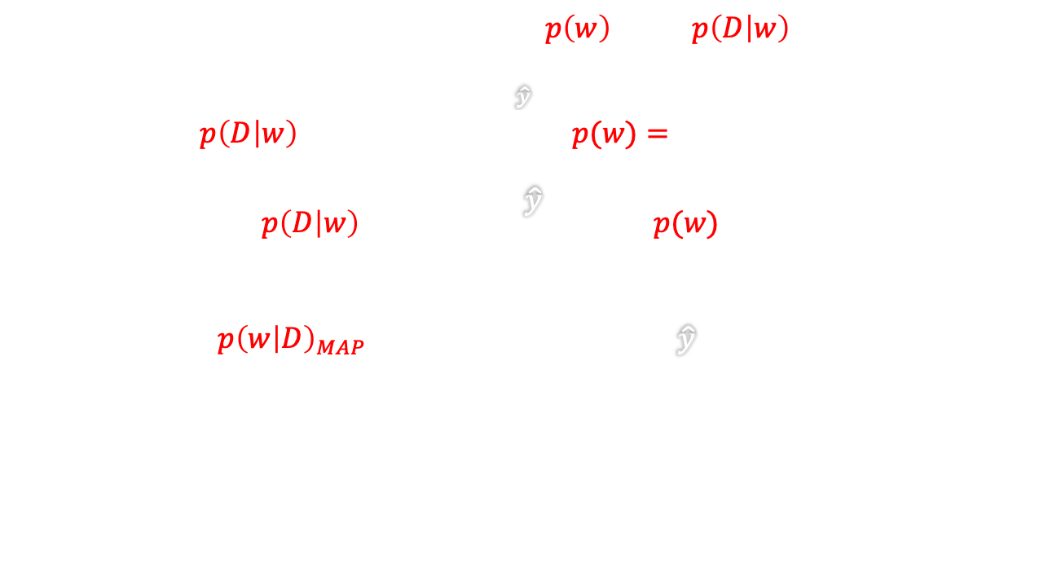
https://towardsdatascience.com/bayesian-thinking-estimating-posterior-distribution-for-linear-regression-data-ketchup-2f50a597eb06
FUNDAMENTALs
Bayes theorem
Maximum a posteriori
$$p\left(w | D\right)=\frac{p\left(D | w\right)p(w)}{p(D)}$$
$$−log p\left(w | D\right)=−log{p\left(w\right)−\log{p\left(D | w\right)}}$$
$$p\left(D | w\right)=\frac{1}{\sqrt{2πσ_{D}^{2} }}e^{−\frac{{\left(D−\hat{y}\right)}^{2}}{2σ_{D}^{2}}} , p(w)=\frac{1}{\sqrt{2πσ_{w}^{2}}}e^{−\frac{{\left(w\right)}^{2}}{2σ_{w}^{2}}}$$
$$−log{p\left(D | w\right)}=k+\frac{{\left(D−\hat{y}\right)}^{2}}{2σ_{D}^{2}},−log{p(w)}=k+\frac{w^{2}}{2σ_{w}^{2}}$$
$$−log p{\left(w | D\right)}_{MAP}=Cost=\frac{1}{2σ_{D}^{2}}\sum_{c}{{\left(t_{c}−{\hat{y}}_{c}\right)}^{2}}+\frac{1}{2σ_{w}^{2}}\sum_{i}{w_{i}^{2}}$$
-$D:observed data$
-$w:parameters of regression line$
-$σ_{D}^{2}:data variance$
-$σ_{w}^{2}:parameter variance$
$Posterior$: $p\left(w | D\right)$
$Likelihood$:$p\left(D | w\right)$
$Prior$:$p(w)$
$Evidence$:$p(D)$

Slide 23
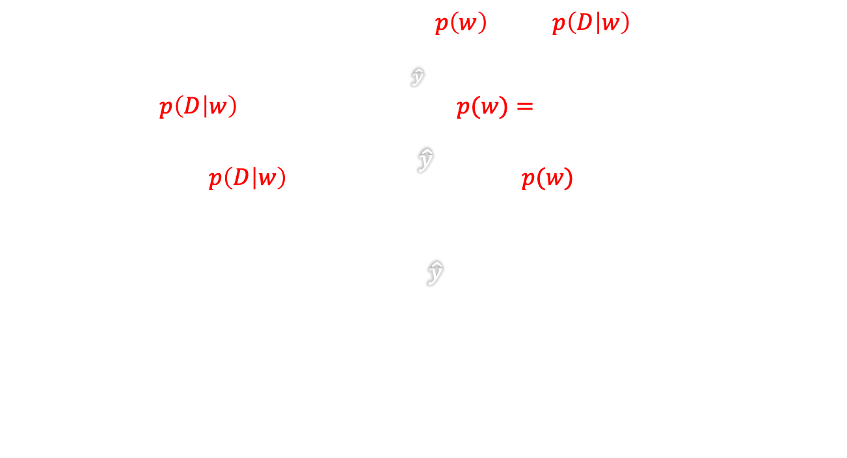
https://towardsdatascience.com/bayesian-thinking-estimating-posterior-distribution-for-linear-regression-data-ketchup-2f50a597eb06
FUNDAMENTALs
Bayes theorem
Maximum a posteriori
$$p\left(w | D\right)=\frac{p\left(D | w\right)p(w)}{p(D)}$$
$$−log p\left(w | D\right)=−log{p\left(w\right)−\log{p\left(D | w\right)}}$$
$$p\left(D | w\right)=\frac{1}{\sqrt{2πσ_{D}^{2} }}e^{−\frac{{\left(D−\hat{y}\right)}^{2}}{2σ_{D}^{2}}} , p(w)=\frac{1}{\sqrt{2πσ_{w}^{2}}}e^{−\frac{{\left(w\right)}^{2}}{2σ_{w}^{2}}}$$
$$−log{p\left(D | w\right)}=k+\frac{{\left(D−\hat{y}\right)}^{2}}{2σ_{D}^{2}},−log{p(w)}=k+\frac{w^{2}}{2σ_{w}^{2}}$$
$$Cost^{∗}=\sum_{c}{{\left(t_{c}−{\hat{y}}_{c}\right)}^{2}}+\frac{σ_{D}^{2}}{σ_{w}^{2}}\sum_{i}{w_{i}^{2}}$$
-$D:observed data$
-$w:parameters of regression line$
-$σ_{D}^{2}:data variance$
-$σ_{w}^{2}:parameter variance$
$Posterior$: $p\left(w | D\right)$
$Likelihood$:$p\left(D | w\right)$
$Prior$:$p(w)$
$Evidence$:$p(D)$

Slide 24
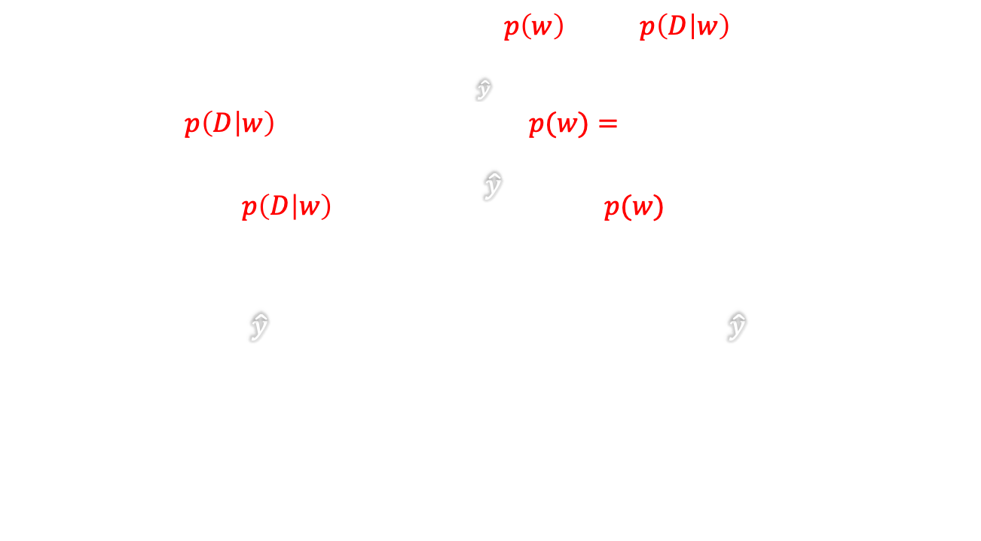
https://towardsdatascience.com/bayesian-thinking-estimating-posterior-distribution-for-linear-regression-data-ketchup-2f50a597eb06
FUNDAMENTALs
Bayes theorem
Maximum a posteriori
$$p\left(w | D\right)=\frac{p\left(D | w\right)p(w)}{p(D)}$$
$$−log p\left(w | D\right)=−log{p\left(w\right)−\log{p\left(D | w\right)}}$$
$$p\left(D | w\right)=\frac{1}{\sqrt{2πσ_{D}^{2} }}e^{−\frac{{\left(D−\hat{y}\right)}^{2}}{2σ_{D}^{2}}} , p(w)=\frac{1}{\sqrt{2πσ_{w}^{2}}}e^{−\frac{{\left(w\right)}^{2}}{2σ_{w}^{2}}}$$
$$−log{p\left(D | w\right)}=k+\frac{{\left(D−\hat{y}\right)}^{2}}{2σ_{D}^{2}},−log{p(w)}=k+\frac{w^{2}}{2σ_{w}^{2}}$$
$$Cost^{∗}=\sum_{c}{{\left(t_{c}−{\hat{y}}_{c}\right)}^{2}}+\frac{σ_{D}^{2}}{σ_{w}^{2}}\sum_{i}{w_{i}^{2}}→Cost^{⋄}=\frac{1}{N}\sum_{c=1}^{N}{{\left(t_{c}−{\hat{y}}_{c}\right)}^{2}}+λ\frac{1}{M}\sum_{i=1}^{M}{w_{i}^{2}}$$
-$D:observed data$
-$w:parameters of regression line$
-$σ_{D}^{2}:data variance$
-$σ_{w}^{2}:parameter variance$
$Posterior$: $p\left(w | D\right)$
$Likelihood$:$p\left(D | w\right)$
$Prior$:$p(w)$
$Evidence$:$p(D)$
Weight decay

Slide 25
https://towardsdatascience.com/bayesian-thinking-estimating-posterior-distribution-for-linear-regression-data-ketchup-2f50a597eb06
FUNDAMENTALs
Bayes theorem
Maximum a posteriori
$$p\left(w | D\right)=\frac{p\left(D | w\right)p(w)}{p(D)}$$
$$−log p\left(w | D\right)=−log{p\left(w\right)−\log{p\left(D | w\right)}}$$
$$p\left(D | w\right)=\frac{1}{\sqrt{2πσ_{D}^{2} }}e^{−\frac{{\left(D−\hat{y}\right)}^{2}}{2σ_{D}^{2}}} , p(w)=\frac{1}{\sqrt{2πσ_{w}^{2}}}e^{−\frac{{\left(w\right)}^{2}}{2σ_{w}^{2}}}$$
$$−log{p\left(D | w\right)}=k+\frac{{\left(D−\hat{y}\right)}^{2}}{2σ_{D}^{2}},−log{p(w)}=k+\frac{w^{2}}{2σ_{w}^{2}}$$
$$Cost^{∗}=\sum_{c}{{\left(t_{c}−{\hat{y}}_{c}\right)}^{2}}+\frac{σ_{D}^{2}}{σ_{w}^{2}}\sum_{i}{w_{i}^{2}}→Cost^{⋄}=\frac{1}{N}\sum_{c=1}^{N}{{\left(t_{c}−{\hat{y}}_{c}\right)}^{2}}+λ\frac{1}{M}\sum_{i=1}^{M}{w_{i}^{2}}$$
-$D:observed data$
-$w:parameters of regression line$
-$σ_{D}^{2}:data variance$
-$σ_{w}^{2}:parameter variance$
$Posterior$: $p\left(w | D\right)$
$Likelihood$:$p\left(D | w\right)$
$Prior$:$p(w)$
$Evidence$:$p(D)$
When to use?
Weight decay

Slide 26
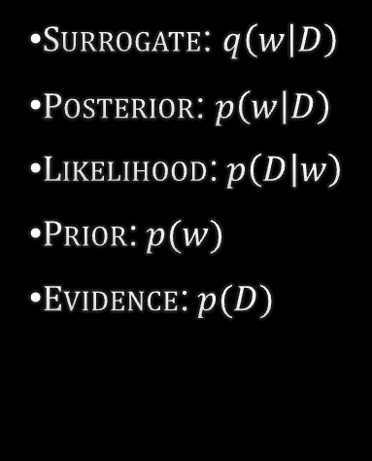
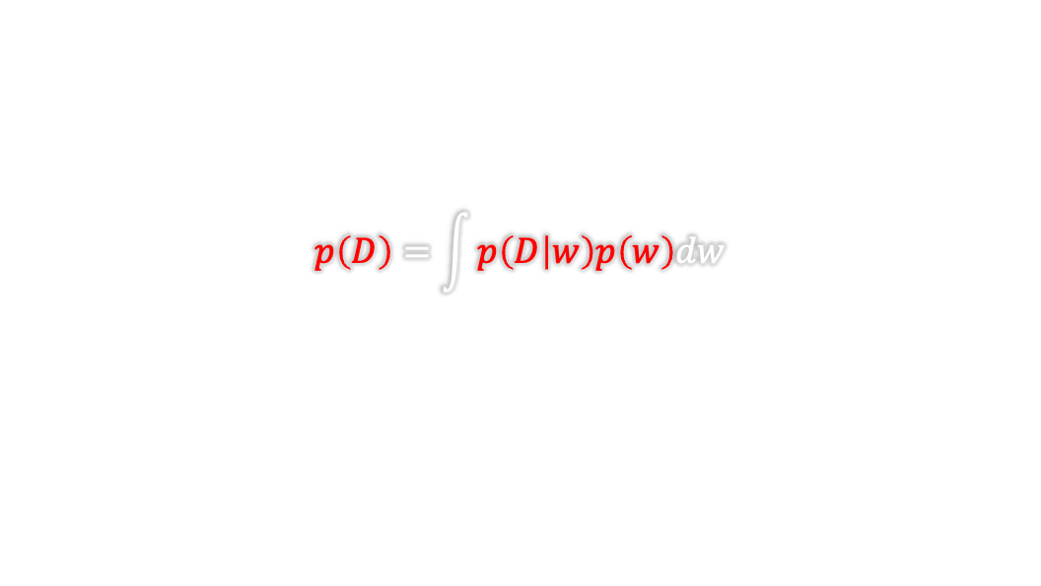
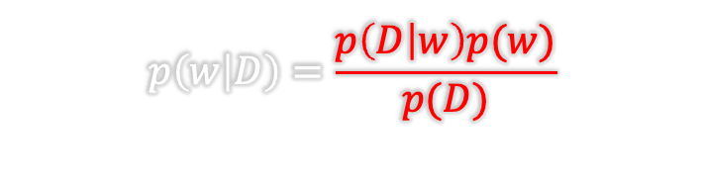
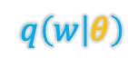
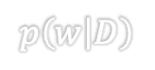
https://towardsdatascience.com/bayesian-thinking-estimating-posterior-distribution-for-linear-regression-data-ketchup-2f50a597eb06
FUNDAMENTALs
Bayes theorem
Full Bayesian? Do we need it?
$$p\left(w | D\right)=\frac{p\left(D | w\right)p(w)}{p(D)}$$
$$p\left(D\right)=\int{p\left(D | w\right)p\left(w\right)dw}$$
$Surrogate$: $q\left(w | D\right)$
$Posterior$: $p\left(w | D\right)$
$Likelihood$:$p\left(D | w\right)$
$Prior$:$p(w)$
$Evidence$:$p(D)$
$$p\left(w | D\right)$$
$$q\left(w | θ\right)$$

Slide 27

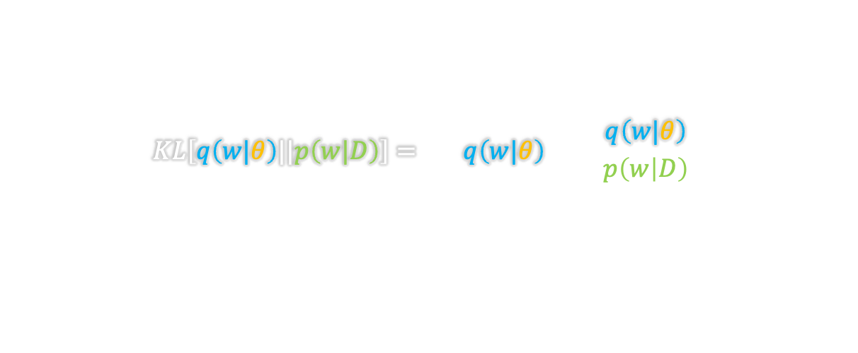
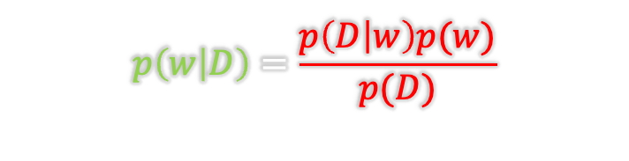
https://towardsdatascience.com/bayesian-thinking-estimating-posterior-distribution-for-linear-regression-data-ketchup-2f50a597eb06
FUNDAMENTALs
Bayes theorem
Full Bayesian?
$$p\left(w | D\right)=\frac{p\left(D | w\right)p(w)}{p(D)}$$
Kullback-Leibler (KL) Divergence
$$KL\left[q\left(w|θ\right)||p\left(w|D\right)\right]=\sum_{w}{q\left(w|θ\right)\log\left(\frac{q\left(w|θ\right)}{p\left(w | D\right)}\right)}$$
$$p\left(D\right)=\int{p\left(D | w\right)p\left(w\right)dw}$$
$Surrogate$: $q\left(w | D\right)$
$Posterior$: $p\left(w | D\right)$
$Likelihood$:$p\left(D | w\right)$
$Prior$:$p(w)$
$Evidence$:$p(D)$
$$p\left(w | D\right)$$
$$q\left(w | θ\right)$$

Slide 28

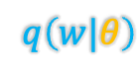

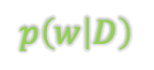
https://towardsdatascience.com/bayesian-thinking-estimating-posterior-distribution-for-linear-regression-data-ketchup-2f50a597eb06
FUNDAMENTALs
Bayes theorem
Full Bayesian?
$$p\left(w | D\right)=\frac{p\left(D | w\right)p(w)}{p(D)}$$
Kullback-Leibler (KL) Divergence
$$KL\left[q\left(w|θ\right)||p\left(w|D\right)\right]=\sum_{w}{q\left(w|θ\right)\log\left(\frac{q\left(w|θ\right)}{p\left(w | D\right)}\right)}$$
$$p\left(D\right)=\int{p\left(D | w\right)p\left(w\right)dw}$$
Variational free energy or expected lower bound
(Saul et al., 1996, Neal and Hinton, 1998)
$Surrogate$: $q\left(w | D\right)$
$Posterior$: $p\left(w | D\right)$
$Likelihood$:$p\left(D | w\right)$
$Prior$:$p(w)$
$Evidence$:$p(D)$
$$θ^{∗}=\underset{θ}{arg min}{KL\left[q\left(w|θ\right)||p\left(w\right)\right]−E\left[log\left(p(D|w)\right)\right]}$$
$$p\left(w | D\right)$$
$$q\left(w|θ\right)$$

Slide 29
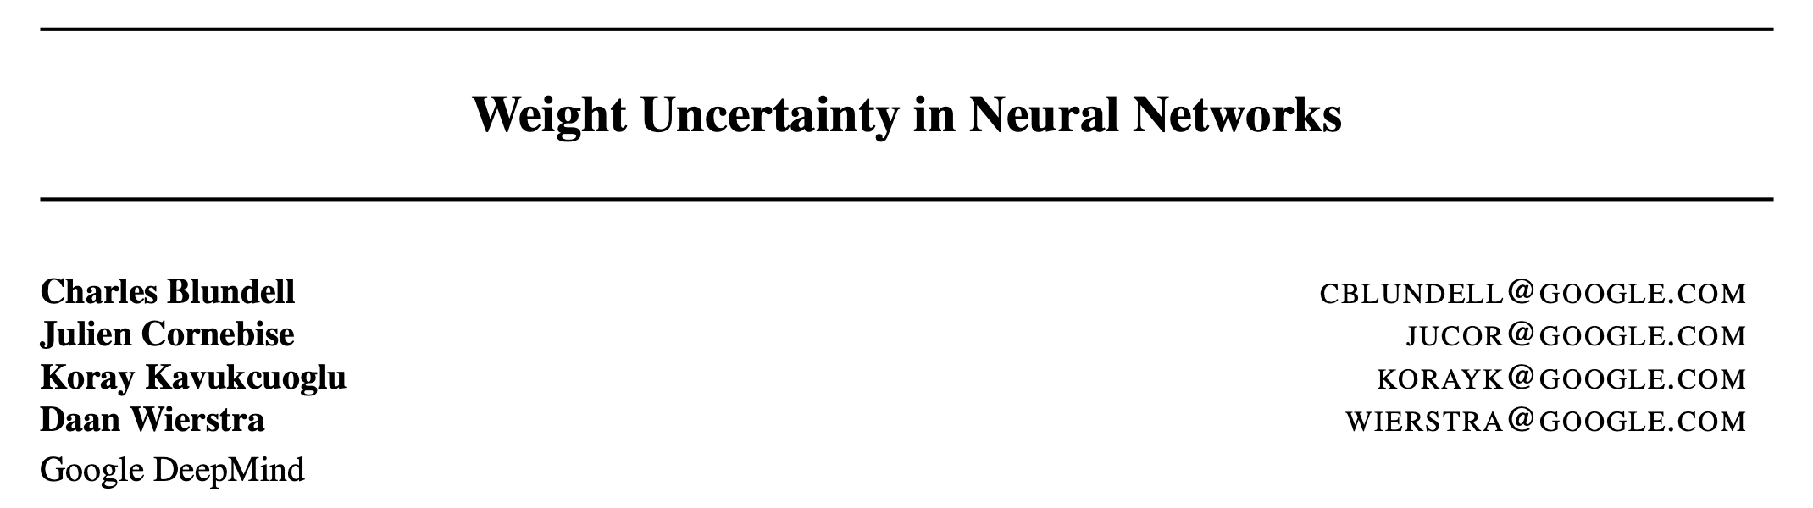
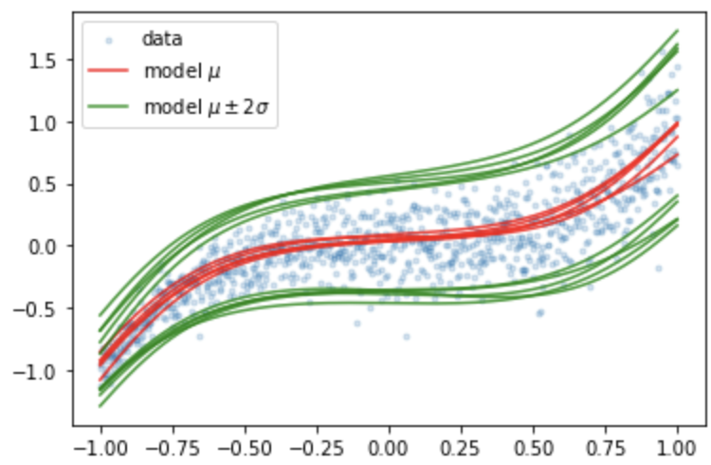

https://towardsdatascience.com/bayesian-thinking-estimating-posterior-distribution-for-linear-regression-data-ketchup-2f50a597eb06
FUNDAMENTALs
Bayes theorem
Full Bayesian?
$$p\left(w | D\right)=\frac{p\left(D | w\right)p(w)}{p(D)}$$
Variational free energy or expected lower bound
(Saul et al., 1996, Neal and Hinton, 1998)
$$θ^{∗}=\underset{θ}{arg min}{KL\left[q\left(w|θ\right)||p\left(w\right)\right]−E\left[log\left(p(D|w)\right)\right]}$$
$$p\left(D\right)=\int{p\left(D | w\right)p\left(w\right)dw}$$
$Surrogate$: $q\left(w | D\right)$
$Posterior$: $p\left(w | D\right)$
$Likelihood$:$p\left(D | w\right)$
$Prior$:$p(w)$
$Evidence$:$p(D)$
$$p\left(w | D\right)$$
$$Aleatoric uncertainty$$
$$Epistemic uncertainty$$
$$q\left(w|θ\right)$$
Notes:
So the lesson is that using maximum likelihood

Slide 30
https://towardsdatascience.com/bayesian-thinking-estimating-posterior-distribution-for-linear-regression-data-ketchup-2f50a597eb06
FUNDAMENTALs
Bayes theorem
Full Bayesian?
$$p\left(w | D\right)=\frac{p\left(D | w\right)p(w)}{p(D)}$$
🥵
Variational free energy or expected lower bound
(Saul et al., 1996, Neal and Hinton, 1998)
$$θ^{∗}=\underset{θ}{arg min}{KL\left[q\left(w|θ\right)||p\left(w\right)\right]−E\left[log\left(p(D|w)\right)\right]}$$
$$p\left(D\right)=\int{p\left(D | w\right)p\left(w\right)dw}$$
$Surrogate$: $q\left(w | D\right)$
$Posterior$: $p\left(w | D\right)$
$Likelihood$:$p\left(D | w\right)$
$Prior$:$p(w)$
$Evidence$:$p(D)$
$$p\left(w | D\right)$$
$$Aleatoric uncertainty$$
$$Epistemic uncertainty$$
$$q\left(w|θ\right)$$
Notes:
So the lesson is that using maximum likelihood

Slide 31
“Motivating” “examples”

Slide 32



Do I have the disease?
$$p\left(A | B\right)=\frac{p\left(B | A\right)p(A)}{p(B)}$$
https://www.youtube.com/watch?v=R13BD8qKeTg&t=254s
Test sample

Slide 33

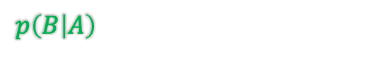
Do I have the disease?
$$p\left(A | B\right)=\frac{p\left(B | A\right)p(A)}{p(B)}$$
https://www.youtube.com/watch?v=R13BD8qKeTg&t=254s
A: have the disease
B: test positive
Test positive
$p\left(B | A\right)$: 0.99 (very accurate test)

Slide 34
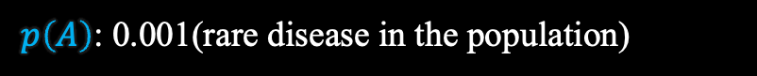

Do I have the disease?
$$p\left(A | B\right)=\frac{p\left(B | A\right)p(A)}{p(B)}$$
https://www.youtube.com/watch?v=R13BD8qKeTg&t=254s
?
A: have the disease
B: test positive
Test positive
$p\left(B | A\right)$: 0.99 (very accurate test)
$p\left(A\right)$: 0.001(rare disease in the population)

Slide 35
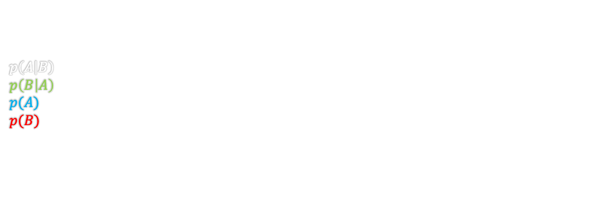

Do I have the disease?
$$p\left(A | B\right)=\frac{p\left(B | A\right)p(A)}{p(B)}$$
https://www.youtube.com/watch?v=R13BD8qKeTg&t=254s
?
A: have the disease
B: test positive
$p\left(A | B\right)$: have the disease |given| test positive
$p\left(B | A\right)$: test positive |given| have the disease - 0.99 (very accurate test)
$p(A)$: have the disease - 0.001(rare disease in the population)
$p(B)$: test positive

Slide 36
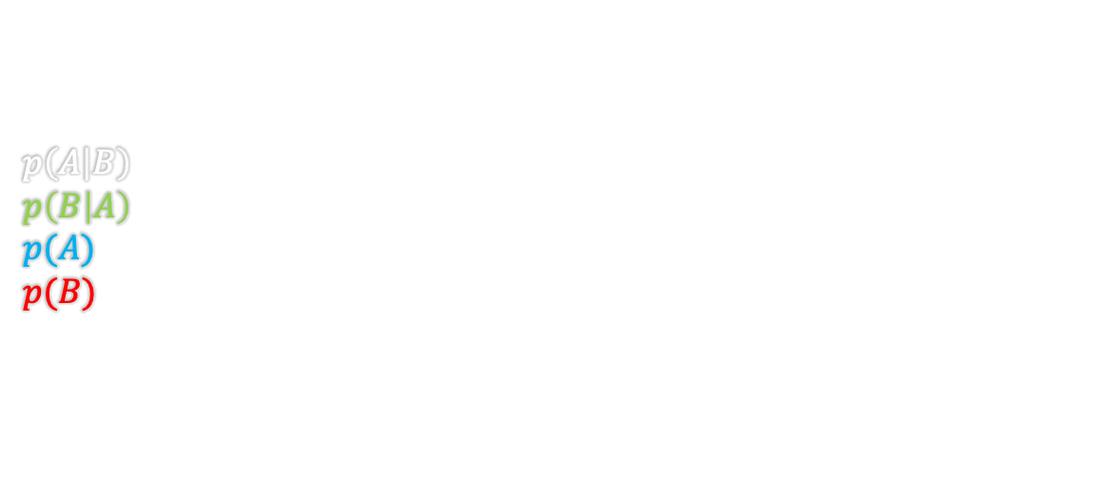
Do I have the disease?
$$p\left(A | B\right)=\frac{p\left(B | A\right)p(A)}{p(B)}$$
https://www.youtube.com/watch?v=R13BD8qKeTg&t=254s
?
A: have the disease
B: test positive
$p\left(A | B\right)$: have the disease |given| test positive
$p\left(B | A\right)$: test positive |given| have the disease - 0.99 (very accurate test)
$p(A)$: have the disease - 0.001(rare disease in the population)
$p(B)$: test positive
$$p\left(A | B\right)=\frac{0.99∗0.001}{0.99∗0.001+0.01∗0.999}=0.09→9\% chance 🤔$$

Slide 37
Do I have the disease?
$$p\left(A | B\right)=\frac{p\left(B | A\right)p(A)}{p(B)}$$
https://www.youtube.com/watch?v=R13BD8qKeTg&t=254s
Test sample
A: have the disease
B: test positive
$p\left(A | B\right)$: have the disease |given| test positive
$p\left(B | A\right)$: test positive |given| have the disease - 0.99 (very accurate test)
$p(A)$: have the disease - 0.001(rare disease in the population)
$p(B)$: test positive
Test positive
$$p\left(A | B\right)=\frac{0.99∗0.001}{0.99∗0.001+0.01∗0.999}=0.09→9\% chance 🤔$$
$$p\left(A | B\right)=\frac{0.99∗0.09}{0.99∗0.09+0.01∗0.91}=0.9073319→91\% chance$$

Slide 38

Certain

Slide 39

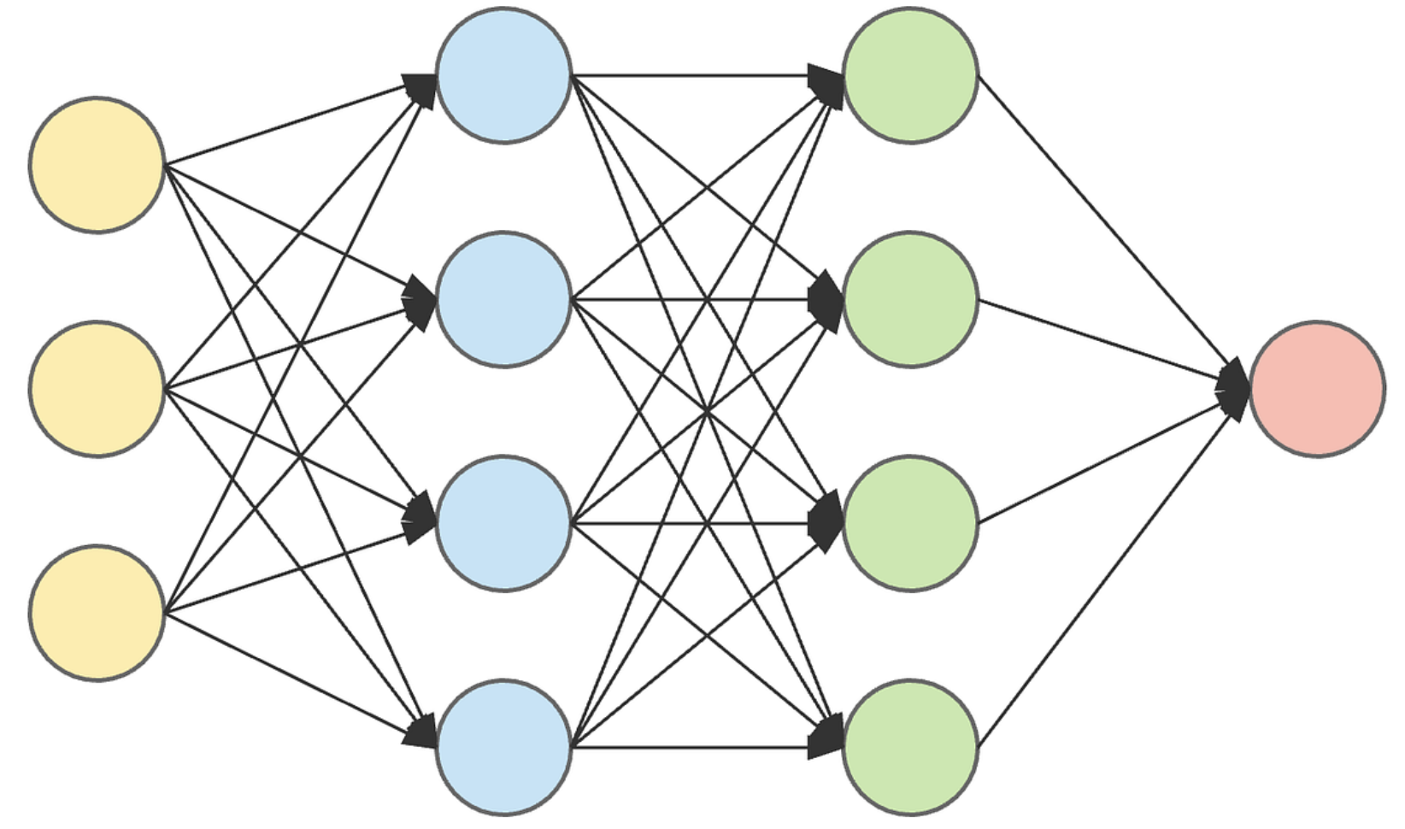

Certain
50
45
5
100 Cases
Easy | Normal | Hard

Slide 40
The deterministic doctor
Pred.\Diff. | Easy | Normal | Hard
TP/TN | 45 | 35 | 4
FP | 5 | 9 | 1
FN | 0 | 1 | 0
50
45
5
100 Cases
Easy | Normal | Hard

Slide 41
The deterministic doctor
Score: 84/100
Pred.\Diff. | Easy | Normal | Hard
TP/TN | 45 | 35 | 4
FP | 5 | 9 | 1
FN | 0 | 1 | 0
50
45
5
100 Cases
Easy | Normal | Hard

Slide 42
The deterministic doctor
The deterministic NN
Score: 84/100
Pred.\Diff. | Easy | Normal | Hard
TP/TN | 45 | 35 | 4
FP | 5 | 9 | 1
FN | 0 | 1 | 0
Pred.\Diff. | Easy | Normal | Hard
TP/TN | 50 | 42 | 1
FP | 0 | 0 | 1
FN | 0 | 3 | 3
50
45
5
100 Cases
Easy | Normal | Hard
Notes:
What is the problem here?
Why are they disagreeing so much?

Slide 43
The deterministic doctor
The deterministic NN
Score: 84/100
Score: 93/100
Pred.\Diff. | Easy | Normal | Hard
TP/TN | 45 | 35 | 4
FP | 5 | 9 | 1
FN | 0 | 1 | 0
Pred.\Diff. | Easy | Normal | Hard
TP/TN | 50 | 42 | 1
FP | 0 | 0 | 1
FN | 0 | 3 | 3
50
45
5
100 Cases
Easy | Normal | Hard
Notes:
What is the problem here?
Why are they disagreeing so much on FP/FN?

Slide 44
The deterministic doctor
The deterministic NN
Score: 84/100
Score: 93/100
Pred.\Diff. | Easy | Normal | Hard
TP/TN | 45 | 35 | 4
FP | 5 | 9 | 1
FN | 0 | 1 | 0
Pred.\Diff. | Easy | Normal | Hard
TP/TN | 50 | 42 | 1
FP | 0 | 0 | 1
FN | 0 | 3 | 3
Who (actually) did the better job?
50
45
5
100 Cases
Easy | Normal | Hard
Notes:
What is the problem here?
Why are they disagreeing so much on FP/FN?

Slide 45
The deterministic doctor
The deterministic NN
Score: 84/100
Score: 93/100
Pred.\Diff. | Easy | Normal | Hard
TP/TN | 45 | 35 | 4
FP | 5 | 9 | 1
FN | 0 | 1 | 0
Disagreements?
Pred.\Diff. | Easy | Normal | Hard
TP/TN | 50 | 42 | 1
FP | 0 | 0 | 1
FN | 0 | 3 | 3
Who (actually) did the better job?
What does lov… uncertainty got to do with it?
50
45
5
100 Cases
Easy | Normal | Hard
Notes:
What is the problem here?
Why are they disagreeing so much on FP/FN?

Slide 46








Hard
$$x_{0}$$
$$C(lass)=P(ositive)$$
doctor
NN
$$p(C|X=x_{0})$$
$$p(C|X=x_{0})$$
Decicion boundry
$$P$$
$$N$$
$$P$$
$$N$$
Notes:
Why are they disagreeing, what are they disagreeing about?

Slide 47



Hard
$$x_{0}$$
$$C=P$$
doctor
NN
$$p(C|X=x_{0})$$
$$p(C|X=x_{0})$$
Decicion boundry
$$p(C|X=x_{0})$$
$$P$$
$$N$$
$$P$$
$$N$$
$$P$$
$$N$$

Slide 48



Hard
$$x_{0}$$
$$C=P$$
NN1
NN2
100/1000/10000 …. Predictions from different NNs
$$p(C|X=x_{0})$$
$$p(C|X=x_{0})$$
$$…$$
$$→$$
$$p(C|X=x_{0})$$
$$P$$
$$N$$
$$P$$
$$N$$
$$P$$
$$N$$

Slide 49




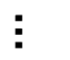
Dog vs. Cat
Training
CNN
Dog
Dog
Cat
Dog
$$…$$

Slide 50


Dog vs. Cat
Training
Inference
CNN
CNN
0.9
Dog
Cat
Dog
Dog
Cat
Dog
$$…$$

Slide 51
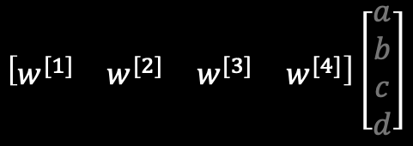
Dog vs. Cat
Inference
CNN
0.9
Cat
Dog
$$\left[\begin{matrix}w^{[1]} & w^{[2]} & w^{[3]} & w^{[4]}\end{matrix}\right]\left[\begin{matrix}a \\ b \\ c \\ d\end{matrix}\right]$$

Slide 52
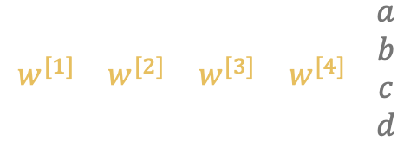
Dog vs. Cat
Inference
CNN
0.9
Cat
Dog
$$\left[\begin{matrix}w^{[1]} & w^{[2]} & w^{[3]} & w^{[4]}\end{matrix}\right]\left[\begin{matrix}a \\ b \\ c \\ d\end{matrix}\right]$$

Slide 53

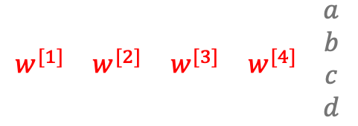
Dog vs. Cat
Inference
CNN
0.9
Cat
Dog
$$…$$
$$\left[\begin{matrix}w^{[1]} & w^{[2]} & w^{[3]} & w^{[4]}\end{matrix}\right]\left[\begin{matrix}a \\ b \\ c \\ d\end{matrix}\right]$$

Slide 54
Dog vs. Cat
Inference
CNN
0.9
Cat
Dog
$$…$$
Cat
Dog

Slide 55
Dog vs. Cat
Inference
CNN
0.9
Cat
Dog
$$…$$
Cat
Dog
Many more layers!

Slide 56
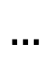

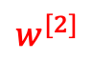
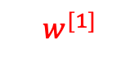
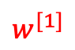
Dog vs. Cat
The deterministic NN
Inference
CNN
0.9
Cat
Dog
$$…$$
Cat
Dog
$$\left[\begin{matrix}w^{[1]} & w^{[2]} & w^{[3]} & w^{[4]}\end{matrix}\right]\left[\begin{matrix}a \\ b \\ c \\ d\end{matrix}\right]$$
$$p(w^{[1]})$$
$$p(w^{[2]})$$
$$…$$
$$w^{[1]}$$
$$w^{[2]}$$

Slide 57
Dog vs. Cat
The stochastic NN
Inference
CNN
0.9
Cat
Dog
$$…$$
Cat
Dog
$$\left[\begin{matrix}w^{[1]} & w^{[2]} & w^{[3]} & w^{[4]}\end{matrix}\right]\left[\begin{matrix}a \\ b \\ c \\ d\end{matrix}\right]$$
$$p(w^{[1]})$$
$$p(w^{[2]})$$
$$…$$
$$w^{[1]}$$
$$w^{[2]}$$

Slide 58

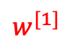
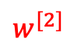
Dog vs. Cat
The stochastic NN
Inference
Sampled weights dims the collar
CNN
0.9
Cat
Dog
$$…$$
Cat
Dog
$$\left[\begin{matrix}w^{[1]} & w^{[2]} & w^{[3]} & w^{[4]}\end{matrix}\right]\left[\begin{matrix}a \\ b \\ c \\ d\end{matrix}\right]$$
$$p(w^{[1]})$$
$$p(w^{[2]})$$
$$…$$
$$w^{[1]}$$
$$w^{[2]}$$

Slide 59


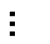
Dog vs. Cat
Inference
CNN
CNN
0.9
Dog
Cat
Dog
Dog
Cat
Dog
$$L$$
$$…$$
$$f\left(x;w\right)=σ\left(w_{2}\left(w_{1}ρ\left(w_{0}x+b_{0}\right)+b_{1}\right)+b_{2}\right)→L\left(w\right)$$
$$w$$

Slide 60
Dog vs. Cat
Inference
CNN
CNN
0.9
Dog
Cat
Dog
Dog
Cat
Dog
Mode
$$L$$
$$…$$
$$f\left(x;w\right)=σ\left(w_{2}\left(w_{1}ρ\left(w_{0}x+b_{0}\right)+b_{1}\right)+b_{2}\right)→L\left(w\right)$$
$$w$$

Slide 61
Dog vs. Cat
Inference
CNN
CNN
0.9
Dog
Cat
Dog
Dog
Cat
Dog
Sample 1
$$L$$
$$…$$
$$f\left(x;w\right)=σ\left(w_{2}\left(w_{1}ρ\left(w_{0}x+b_{0}\right)+b_{1}\right)+b_{2}\right)→L\left(w\right)$$
$$w$$

Slide 62
Dog vs. Cat
Inference
CNN
CNN
0.75
Dog
Cat
Dog
Dog
Cat
Dog
Sample 2
$$L$$
$$…$$
$$f\left(x;w\right)=σ\left(w_{2}\left(w_{1}ρ\left(w_{0}x+b_{0}\right)+b_{1}\right)+b_{2}\right)→L\left(w\right)$$
$$w$$

Slide 63


Hard
$$x_{0}$$
$$C=P$$
Sample 1
Sample 2
Sample N
NN
NN
100/1000/10000 …. Predictions from different NNs
$$p(C|X=x_{0})$$
$$p(C|X=x_{0})$$
$$…$$
$$p(C|X=x_{0})$$
$$P$$
$$N$$
$$P$$
$$N$$
$$P$$
$$N$$

Slide 64
Hard
$$x_{0}$$
$$C=P$$
Sample 1
Sample 2
Sample N
NN
NN
100/1000/10000 …. Predictions from different NNs
Disagree
$$p(C|X=x_{0})$$
$$p(C|X=x_{0})$$
$$…$$
$$→$$
$$p(C|X=x_{0})$$
Decicion boundry
$$P$$
$$N$$
$$P$$
$$N$$
$$P$$
$$N$$

Slide 65
Hard
$$x_{0}$$
$$C=P$$
Sample 1
Sample 2
Sample N
NN
NN
100/1000/10000 …. Predictions from different NNs
Agree
$$p(C|X=x_{0})$$
$$p(C|X=x_{0})$$
$$…$$
$$→$$
$$p(C|X=x_{0})$$
Decicion boundry
$$P$$
$$N$$
$$P$$
$$N$$
$$P$$
$$N$$

Slide 66
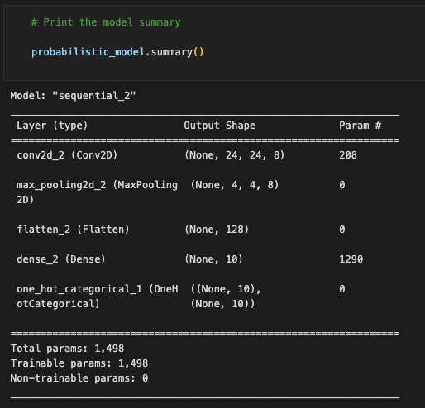
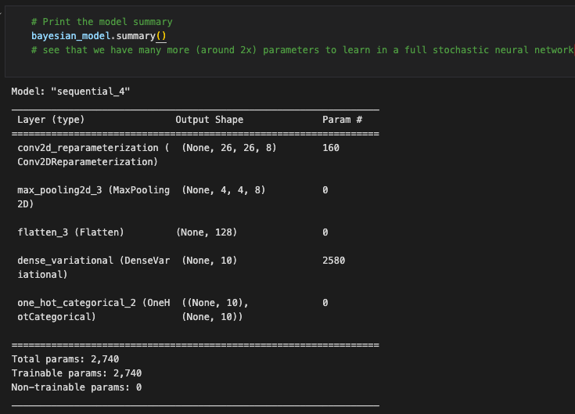

Slide 67






$$p\left(w | D\right)=\frac{p\left(D | w\right)p(w)}{p(D)}$$
$$p\left(w | D\right)=\frac{p\left(D | w\right)p(w)}{p(D)}$$

Slide 68







References and learning material
Articles
Books
Online
https://www.coursera.org/
Blundell, Charles, Julien Cornebise, Koray Kavukcuoglu, and Daan Wierstra. "Weight uncertainty in neural network." In International conference on machine learning, pp. 1613-1622. PMLR, 2015.
Lawrence K Saul, Tommi Jaakkola, and Michael I Jordan. Mean field theory for sigmoid belief networks. Journal of artificial intelligence research, 4(1):61–76, 1996.
Radford M Neal and Geoffrey E Hinton. A view of the EM algorithm that justifies incremental, sparse, and other variants. In Learning in graphical models, pages 355– 368. Springer, 1998.
https://www.youtube.com/@MachineLearningSimulation
https://www.youtube.com/@KapilSachdeva
https://www.youtube.com/@veritasium

